Slide 1
Pipes, Filters
and Redirection
1

Slide 2
OVERVIEW
Will use redirection to redirect standard input and standard output.

Slide 3
OVERVIEW
Learn how pipes can be used
to connect programs.

Slide 4
OVERVIEW
How filters can be used to manipulate data will be explained.

Slide 5
OVERVIEW
What shell extensions are and how they may be used will be discussed.

Slide 6
OVERVIEW
Learn how to combine commands using pipes, filters, and redirection.

Slide 7
REDIRECTION OF STANDARD I/O (INPUT/OUTPUT)
Operating system gets information from or sends information to:
    Standard input
    Standard output
    Standard error

Slide 8
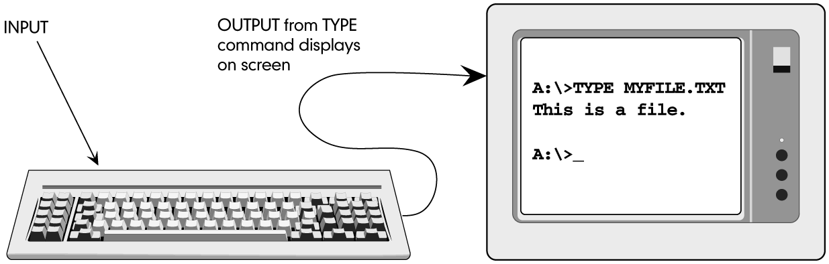
REDIRECTION OF STANDARD I/O (INPUT/OUTPUT)
INPUT AND OUTPUT DEVICES

Slide 9
REDIRECTION OF STANDARD I/O (INPUT/OUTPUT)
Not all commands deal with standard input/output.

Slide 10
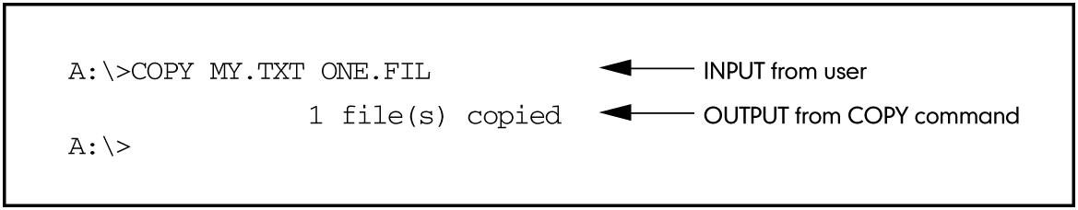
REDIRECTION OF STANDARD I/O (INPUT/OUTPUT)
FIG 9.2 RESULTS OF COPY COMMAND P. 440

Slide 11
REDIRECTION OF STANDARD I/O (INPUT/OUTPUT)
I/O redirection tells OS you want information read from or written to a device other than the
standard ones.

Slide 12
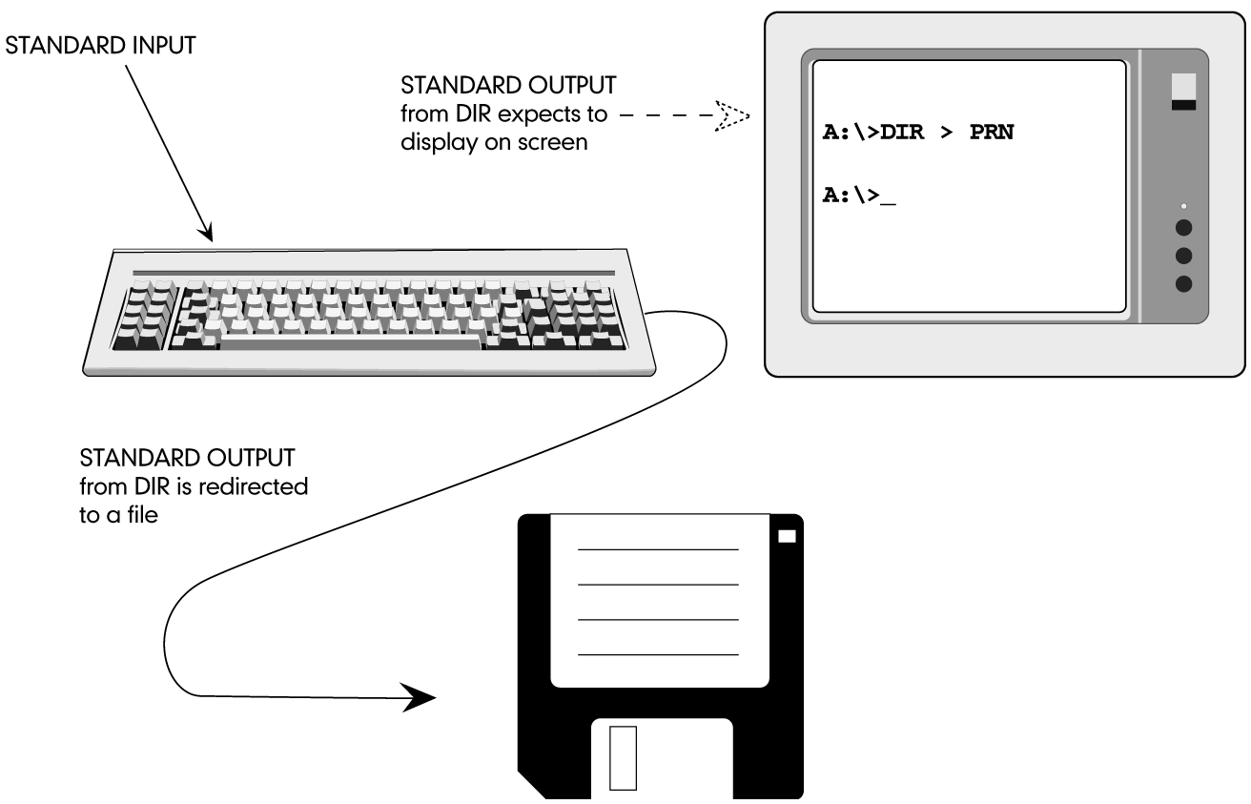
REDIRECTION OF STANDARD I/O (INPUT/OUTPUT)
FIG 9.3 REDIRECTING STANDARD OUTPUT P. 441

Slide 13
REDIRECTION OF STANDARD I/O (INPUT/OUTPUT)
Symbols used for redirection:
        > (greater than)
        < (less than)
        >> (double greater than)

Slide 14
ACTIVITY—USING > TO
REDIRECT STANDARD OUTPUT
KEY CONCEPTS:
  Redirection works with commands that write their results to standard output device (screen)
  Using >
  COPY can only copy files, not commands

Slide 15
ACTIVITY—USING < TO
REDIRECT STANDARD INPUT
KEY CONCEPTS:
  DEL*.* requires keyboard response
  Using <
  Any input from keyboard ignored if redirection of input is from a file

Slide 16
ACTIVITY—USING >> TO ADD REDIRECTED OUTPUT TO A FILE
KEY CONCEPTS:
  Using > between files - first file overwrites second file
  Using >> between files - first file appended to end of second file

Slide 17
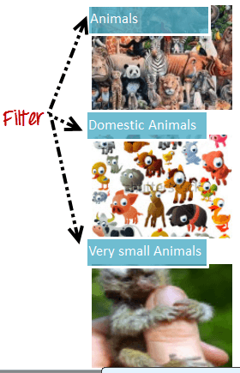

Slide 18
FILTERS
Filter commands
manipulate information.

Slide 19
FILTERS
Three filter commands:
        SORT
        FIND
        MORE

Slide 20
FILTERS
Operating system creates temporary files while it “filters” data.

Slide 21
FILTERS
Operating system will not be able to execute filter commands on write-protected disk.

Slide 22
THE SORT COMMAND
SORT filter command:
  Arranges lines of input in ascending order
  Sends output to standard output unless redirected

Slide 23
THE SORT COMMAND
SORT syntax:
SORT [/R] [/+N] [/M kilobytes] [/L locale] [/REC recordbytes]
[[drive:] [path1] filename1] [/T [drive2:] [path2]] [O [drive3:]
[path3] filename3]

Slide 24
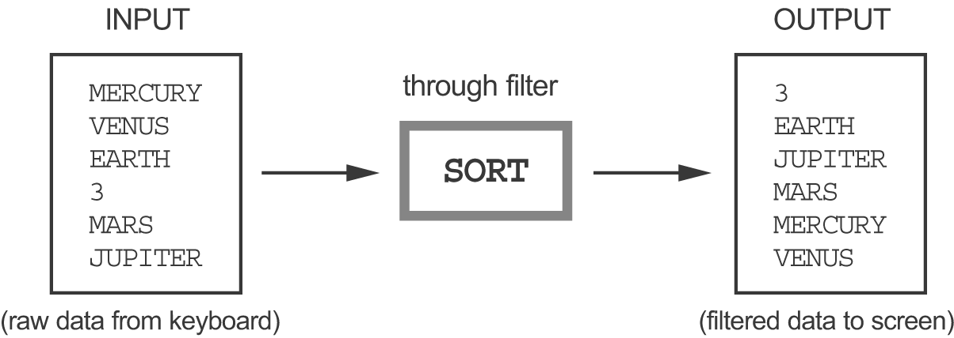
ACTIVITY—USING SORT
FIG 9.4 FILTERING DATA P. 448

Slide 25
ACTIVITY—USING SORT
KEY CONCEPTS:
  Numbers are numbers only when mathematical operation performed on them
  Character data sorted from left to right

Slide 26
ACTIVITY—USING SORT
KEY CONCEPTS:
  ASCII sort sequence order:
    punctuation marks (including spaces)
    numbers
    letters (lowercase then uppercase)

Slide 27
ACTIVITY—USING SORT
KEY CONCEPTS:
  Sort sequence of BB, aa, #, 123, bb, 13, AA
    # 123 13 aa AA bb BB
  Sort sequence of “Carolyn Smith and Robert Nesler”
      Carolyn Smith
      Robert Nesler

Slide 28
ACTIVITY—USING SORT
KEY CONCEPTS:
  Can force OS to sort numbers correctly by using spacebar to add space characters
  Using spaces forces lines to be same length - placing number digits in proper position
  Left justify character data
  Right justify numeric data

Slide 29
FILTERS AND REDIRECTION
Can redirect both output and input of filter commands.
Filter commands not usually used with keyboard input.

Slide 30
ACTIVITY—USING THE SORT COMMAND WITH REDIRECTION
KEY CONCEPTS:
  /R - sorts in reverse or descending order
  /+n - sorts by column number (character number)
  /O - stores sorted data in a file (faster than redirection)

Slide 31
THE FIND FILTER
FIND filter command:
  Allows you to search a file for a specific character string by enclosing it in quotation marks.

Slide 32
THE FIND FILTER
FIND syntax:
FIND [/V] [/C] [/N] [/I] [/OFF[LINE]]“string”
[[drive:] [path] filename[ …]]

Slide 33
THE FIND FILTER
FIND command is looking for exact match, therefore, is case sensitive unless /I parameter
is used.

Slide 34
THE FIND FILTER
FIND command at command line can help find a file based on content.

Slide 35
ACTIVITY—USING THE
FIND FILTER
KEY CONCEPTS:
  With FIND must use double quotes
  Character string must be enclosed in quotes
  FIND is case sensitive

Slide 36
ACTIVITY—USING THE
FIND FILTER
KEY CONCEPTS:
  FIND parameters:
    /I - ignores case
    /V - search a file for anything except what is in quotes
    /N - finds specific line number of each occurrence
    /C - numeric count of number of times specific character string appears in a file

Slide 37
PIPES
Pipes:
  Standard output of one program used as standard input to next program
  Used with filter commands to further refine data

Slide 38
PIPES
Pipe symbol is the vertical broken bar | and is used between two commands.

Slide 39
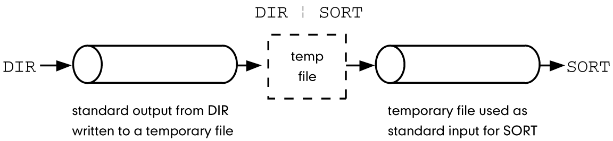
PIPES
FIG 9.5 PIPING COMMANDS P. 457

Slide 40
THE MORE FILTER
MORE filter:
  Useful when reading long text file
  Returns to system prompt when no more data in file

Slide 41
THE MORE FILTER
MORE syntax:
MORE [/E [/C] [/P] [/S] [/Tn] [+n]] < [drive:] [path] filename command-name | MORE [/E [/C] [/P] [/S] [Tn] [+n] MORE /E [/C] [/P] [/S] [/Tn] [+n] [files]

Slide 42
ACTIVITY—USING THE
MORE FILTER
KEY CONCEPTS:
  Locate pipe signal
  Continued pressing of <Spacebar> will return to system prompt
  With extended features pressing Q will break command and return to system prompt
  Can connect several commands with pipes and filters

Slide 43
OTHER FEATURES OF MORE
Bottom of the syntax diagram of MORE command: (Shown earlier)
The following commands are accepted at the –MORE– prompt:
P n Display next n lines
S n Skip next n lines
F Display next file
Q Quit
= Show line number
? Show help line
<space> Display next page
<ret> Display next line

Slide 44
OTHER FEATURES OF MORE
Shell is the command interpreter used to pass commands to operating system.

Slide 45
COMBINING COMMANDS WITH PIPES AND FILTERS
Use of pipe symbol:
  Join commands (output from one command is input to next command)
  Connect two or more programs and create a flow of data

Slide 46
COMBINING COMMANDS WITH PIPES AND FILTERS
When pipe symbol is used, there must be a command on both sides of the actual symbol.
If redirection used with “pipeline”, command does not have to be on either side of > or >>.

Slide 47
COMBINING COMMANDS WITH PIPES AND FILTERS
Redirecting output from a command is an “instead of” process.
Redirection becomes end of pipeline when you combine use of pipes and >.

